Slide 1
Song Recommendation for Social Singing Community
Kuang Mao, Ju Fan, Lidan Shou, Gang Chen, Mohan Kankanhalli
Zhejiang University, National University of Singapore

Slide 2
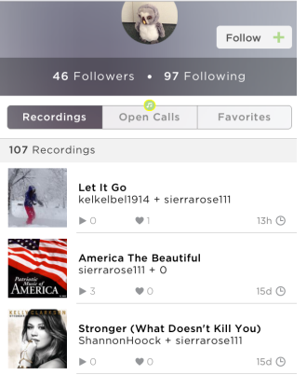
Social Singing Community
Features
Recording your singing performance
Listen other people’s recording
Rating the singing performance
Example
Smule/Sing!: 1B cover songs, 15M users
5sing: 7.5M cover songs, 1.3M users
Sing!

Slide 3
Community Difference
Social Music Community
Social Singing Community
Focus on listeners
Listeners rate the songs and interact with other listeners
Listeners looks for the songs they like to listening
Focus on the singers
Interaction between the singer by rating the performance of other singers’ pieces
Singers look for the songs they are able to perform well

Slide 4
Research Problem
Problem
SInging-song Recommendation (SIR) for a social singing community(SSC)
Objective
Develop a singing song recommendation algorithm which takes users’ singing history as input and recommends songs that each user can get a good singing performance.
Basic Idea
Good singing performance means high listener ratings
Recommend songs that are easier to get a good performance comparing with user’s singing history.
Not recommend easy-to-sing song

Slide 5
Challenges
Discover difficulty relation between two songs
This kind of relation between two songs as difficulty ordering.
To make recommendation, how reliable is the difficulty ordering?
Recommendation based on orderings
Limited difficulty orderings
Do recommendation based on these orderings

Slide 6
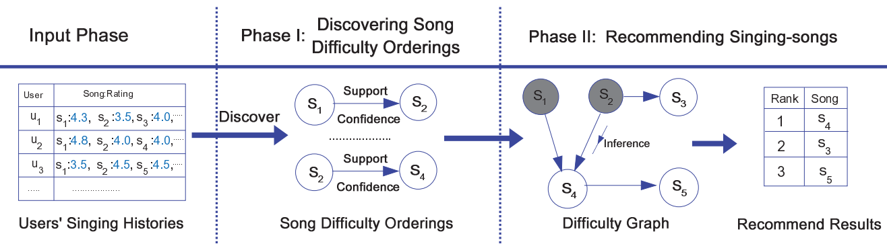
Framework Overview

Slide 7
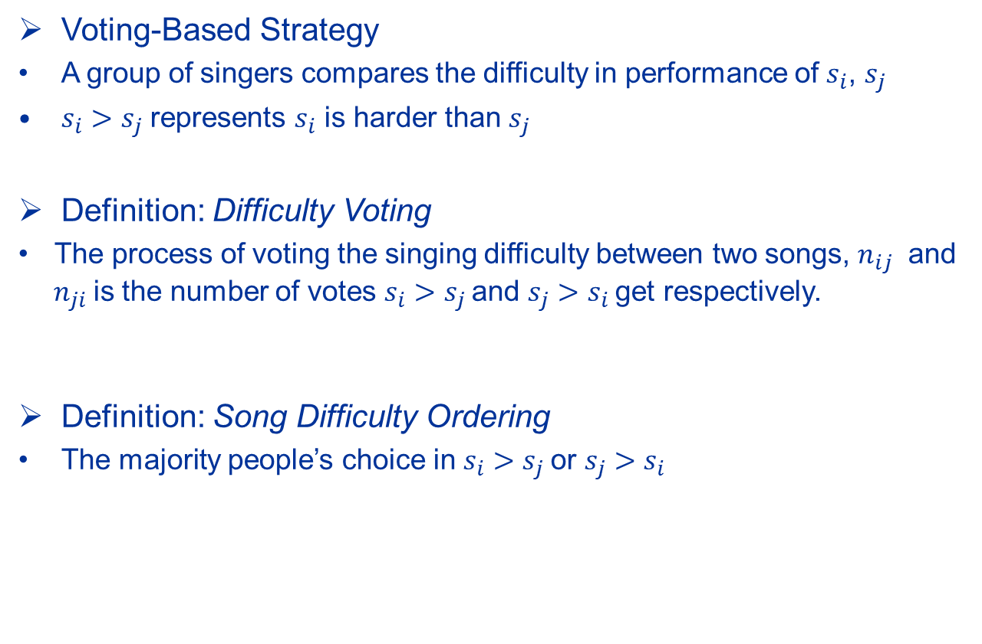
Song Difficulty Ordering
Voting-Based Strategy
A group of singers compares the difficulty in performance of $s_{i}$, $s_{j}$
$s_{i}>s_{j}$ represents $s_{i}$ is harder than $s_{j}$
Definition: Difficulty Voting
  The process of voting the singing difficulty between two songs, $n_{ij}$ and $n_{ji}$is the number of votes $s_{i}>s_{j}$and $s_{j}>s_{i}$get respectively.
Definition: Song Difficulty Ordering
The majority people’s choice in $s_{i}>s_{j}$or $s_{j}>s_{i}$

Slide 8
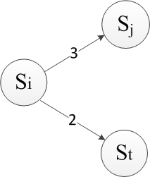
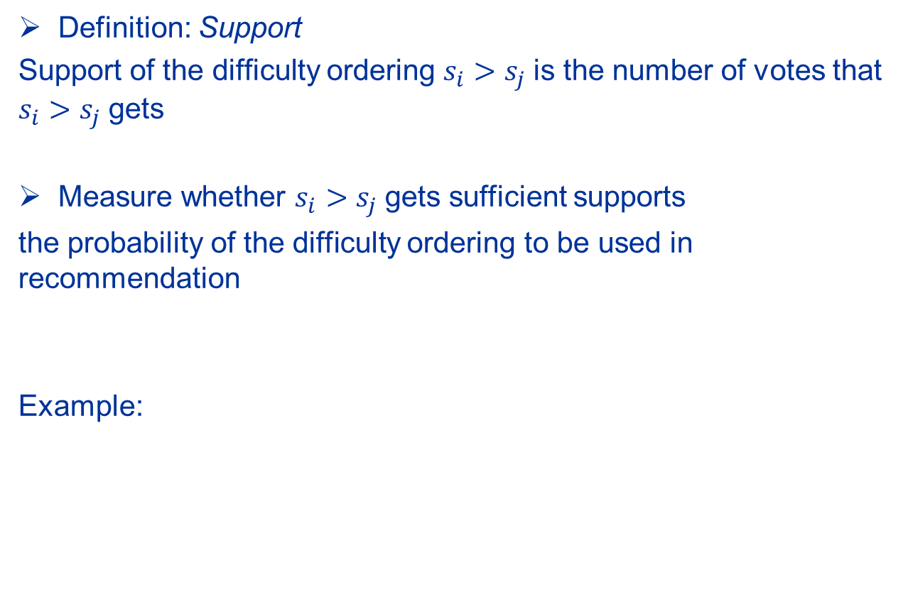
Support of Difficulty Ordering
Definition: Support
Support of the difficulty ordering $s_{i}>s_{j}$is the number of votes that $s_{i}>s_{j}$gets
Measure whether $s_{i}>s_{j}$gets sufficient supports
the probability of the difficulty ordering to be used in recommendation
Example:

Slide 9

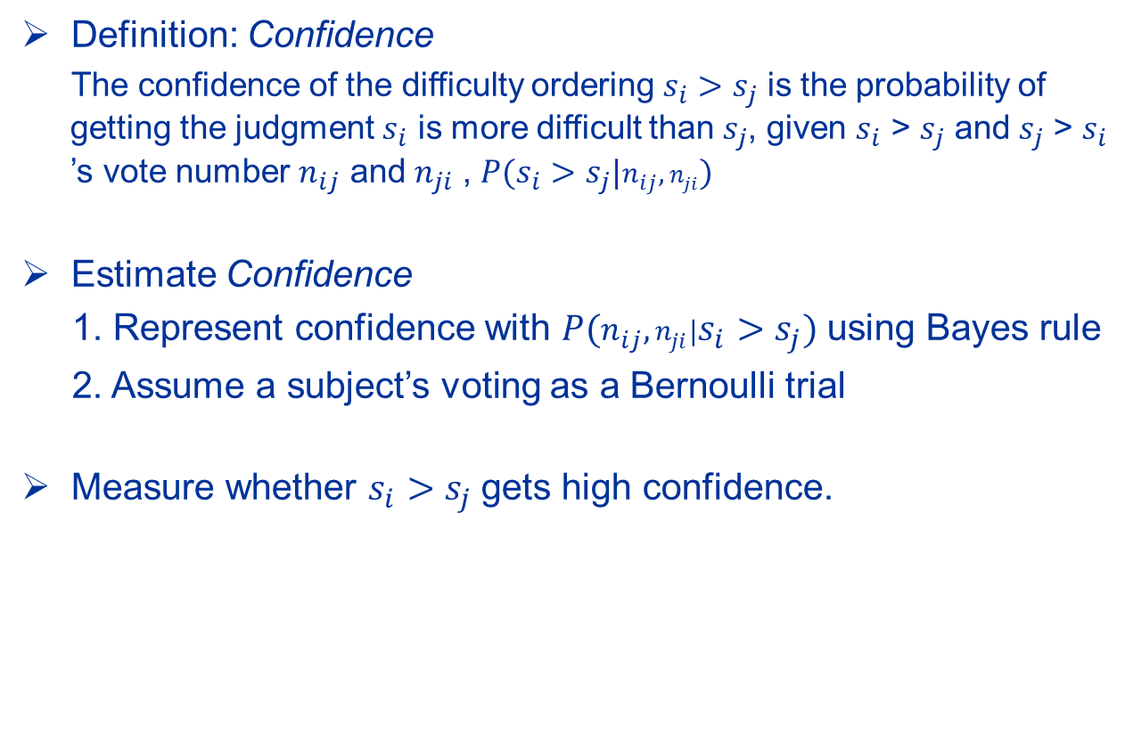
Confidence of Difficulty Ordering
Definition: Confidence
  The confidence of the difficulty ordering $s_{i}>s_{j}$ is the probability of getting the judgment $s_{i}$ is more difficult than $s_{j}$, given $s_{i}$ > $s_{j}$ and $s_{j}$ > $s_{i}$ ’s vote number $n_{ij}$ and $n_{ji}$ , ${P(s}_{i}>s_{j}|n_{ij},n_{ji})$
Estimate Confidence
1. Represent confidence with ${P(n_{ij},n_{ji}|s}_{i}>s_{j})$using Bayes rule
2. Assume a subject’s voting as a Bernoulli trial
Measure whether $s_{i}>s_{j}$gets high confidence.

Slide 10


Reliability of Difficulty Ordering
Definition: Reliabilility
  The reliability of the difficulty ordering $s_{i}>s_{j}$, is the probability of the event that $s_{i}>s_{j}$ gets sufficient supports and a high confidence$.$
Estimate of reliability

Slide 11
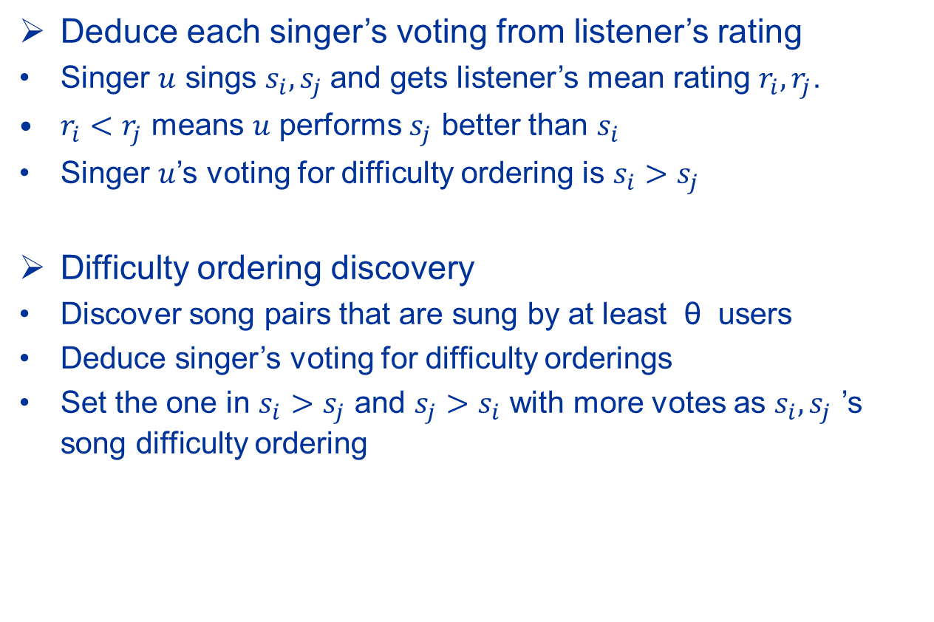
Difficulty Ordering Discovery
Deduce each singer’s voting from listener’s rating
Singer $u$ sings $s_{i}, s_{j}$and gets listener’s mean rating $r_{i},r_{j}$.
$r_{i}<r_{j}$ means $u$ performs $s_{j}$ better than $s_{i}$
Singer $u$’s voting for difficulty ordering is $s_{i}>s_{j}$
Difficulty ordering discovery
Discover song pairs that are sung by at least θ users
Deduce singer’s voting for difficulty orderings
Set the one in $s_{i}>s_{j}$ and $s_{j}>s_{i}$ with more votes as $s_{i}, s_{j}$ ’s song difficulty ordering

Slide 12
Song Recommendation: Basic Idea
Recommendation based on difficulty orderings
Estimate the likelihood that a user can perform the songs well, performance degree
Rank the song based on performance degree.
Estimate the performance degree of each song
Start from user’s singing history as seeds
Exploit through the difficulty orderings to find the songs which have large probabilities to be easier than the seeds
Utilize these probability as performance degree

Slide 13

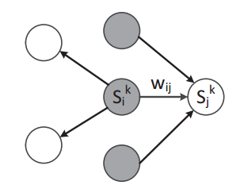
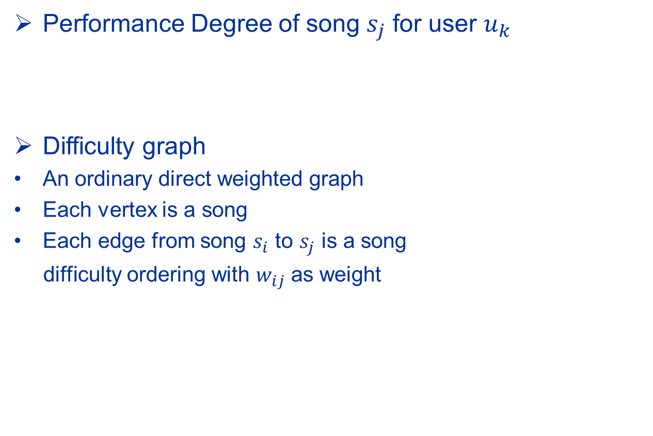
Performance Degree
Performance Degree of song $s_{j}$ for user $u_{k}$
Difficulty graph
An ordinary direct weighted graph
Each vertex is a song
Each edge from song $s_{i}$ to $s_{j}$ is a song
difficulty ordering with $w_{ij}$ as weight

Slide 14


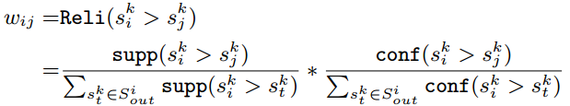

Probabilistic Inference
Infer PD of $s_{j}$ for user k from PD of its in-degree songs
Estimate using sum and product rules
We let
Weight equals to the reliability of $s_{i}>s_{j}$

Slide 15

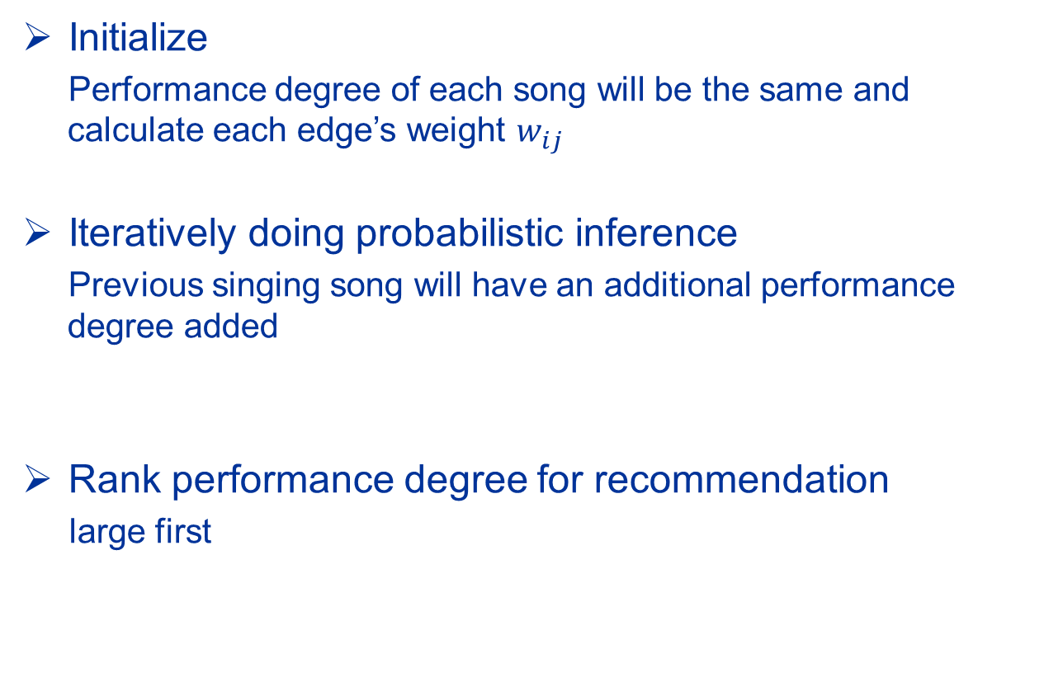
Iterative Probabilistic Inference (IPI)
Initialize
  Performance degree of each song will be the same and calculate each edge’s weight $w_{ij}$
Iteratively doing probabilistic inference
  Previous singing song will have an additional performance degree added
Rank performance degree for recommendation
large first

Slide 16
Experiment Setup
Dataset source
  5sing which is the largest social singing community in China
Note: http://5sing.kugou.com
Song difficulty ordering dataset
  Contain 5877 songs, 257666 difficulty orderings
Singing-song recommendation dataset
  2705 users’ singing histories.
  The mean number of songs sung by each user is 96
For evaluation
  30% songs in each user’s singing history for evaluation purpose, others for training.

Slide 17
Baseline Method
User-based collaborative filtering (CF)
  Songs sang by each user will have a 5-graded rating. Our objective is to predict the rating for other unrated songs
Ordinary Graph based Recommendation (OGR)
  We build an undirected graph with song and user as vertex,
  user’s singing relation as edge.
Measuring reliability using only Support (IPI-supp)
  Ranking algorithm using IPI
Measuring reliability using only Confidence (IPI-conf)
  Ranking algorithm using IPI

Slide 18
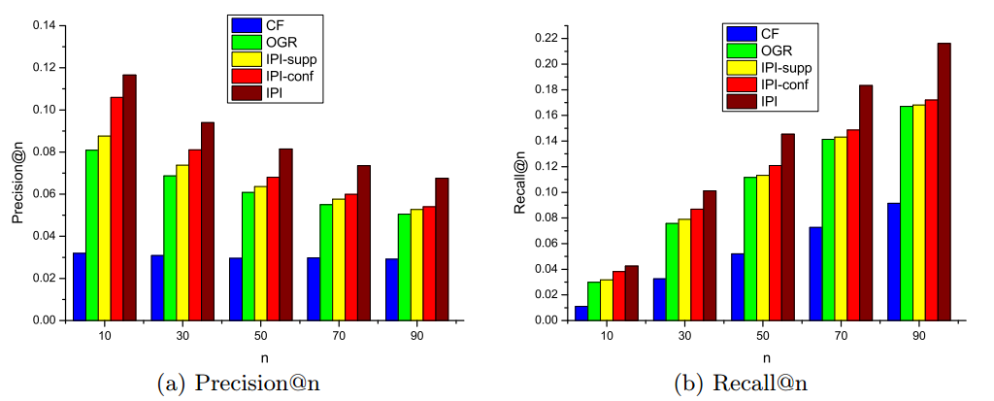
Baseline Comparison

Slide 19
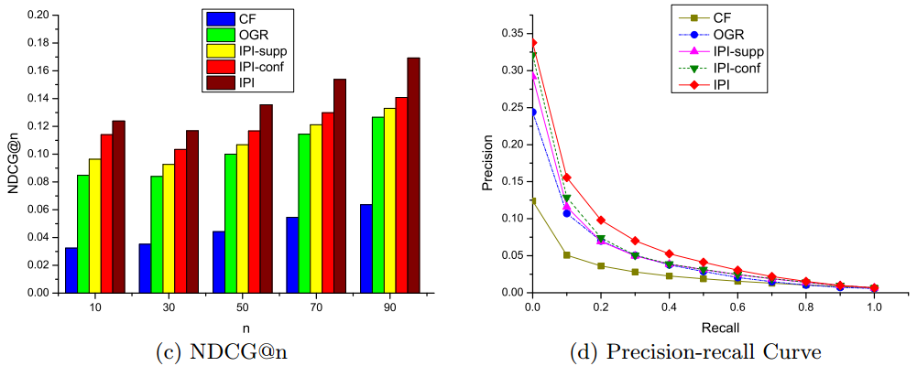
Baseline Comparison

Slide 20
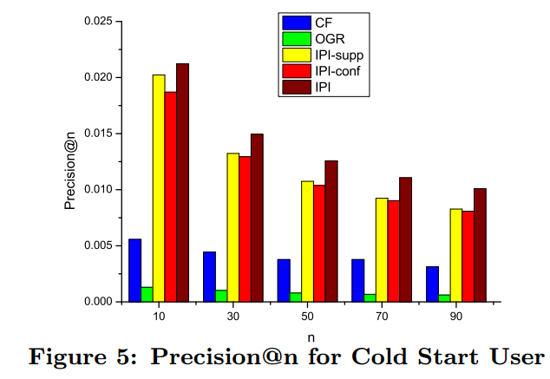
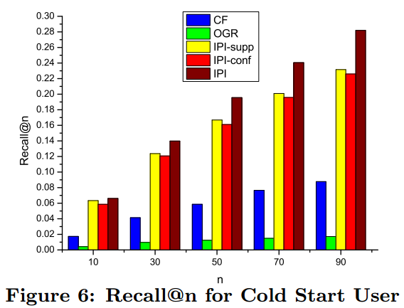
Test for Cold Start User
Sparse dataset
  3000 users, each sings 7-10 songs

Slide 21
Future Works
Discovering more difficulty orderings from other sources of social singing community to maintain a complete difficulty orderings database
Exploit other factors such as users’ singing preference as well as friendship relation to study if they can help make the recommendation better

